Slide 1
冒險故事(Vtube Studio)

Slide 2
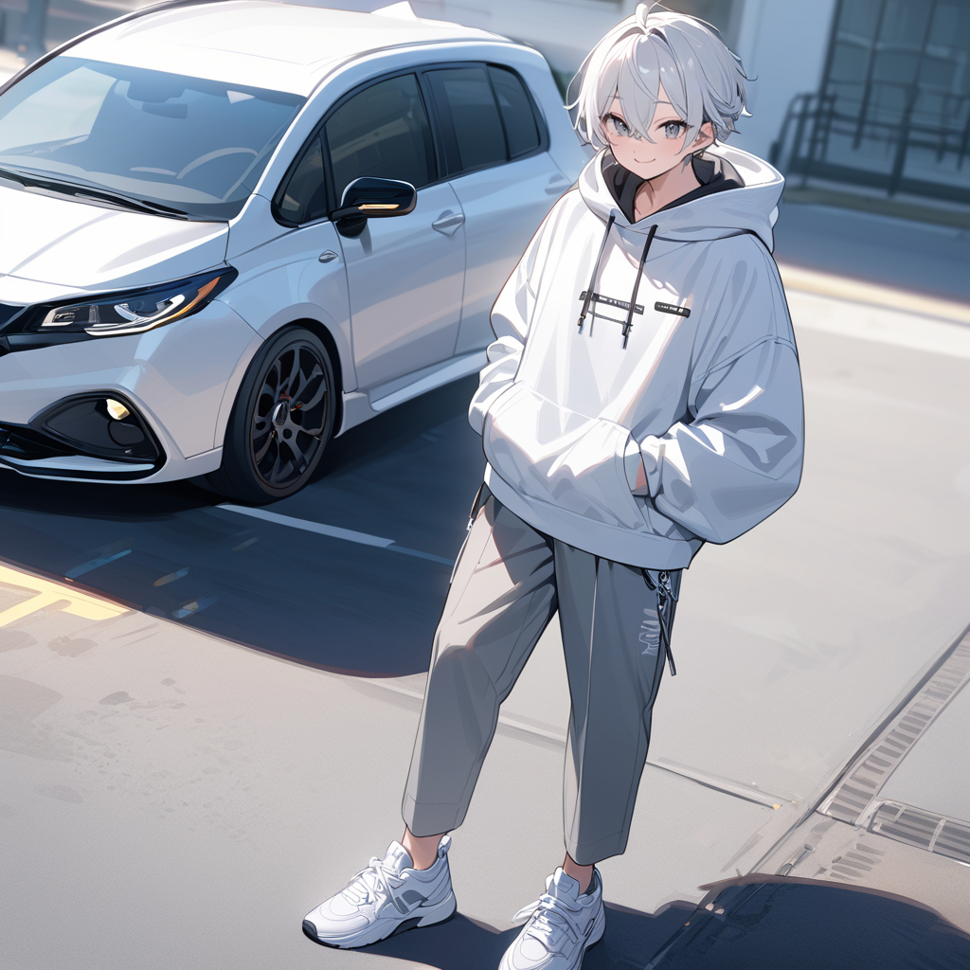
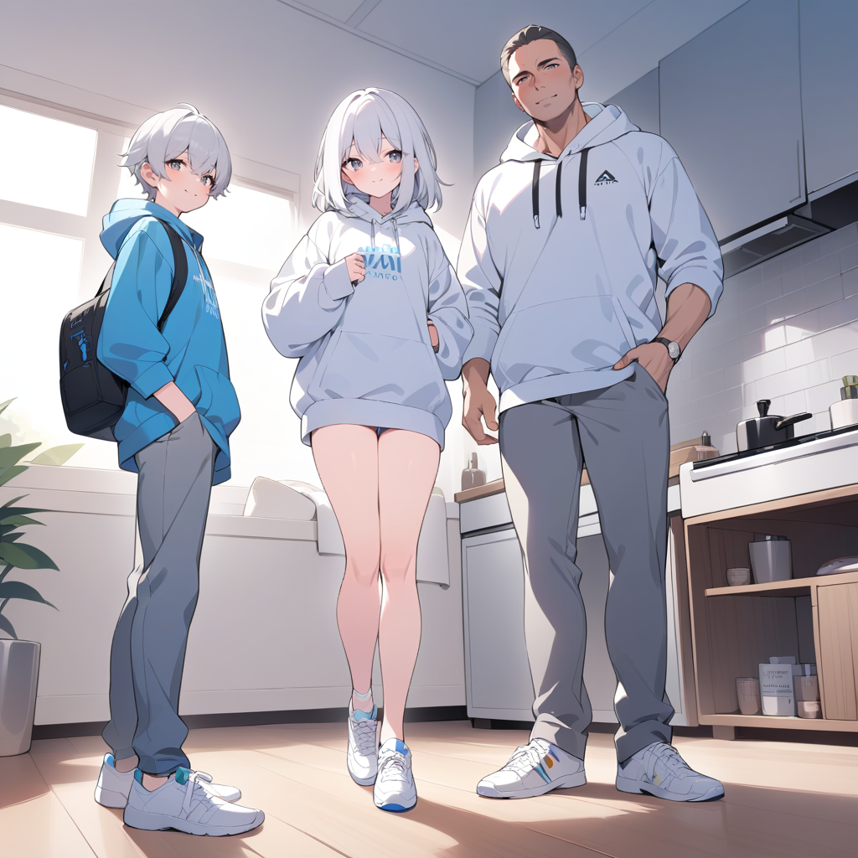
Notes:
stable diffusion：
masterpiece, best quality, 1dad, 1mom, 1boy, in the house, prepare to travel, virtual youtuber, happy, hood, pants, shoes, jacket, white hoodie, looking at viewer, white hair, gray eyes, hoodie, sneakers, hair between eyes, standing, jewelry, grey pants, white footwear, bangs
nsfw,(worst quality, low quality:1.4),(extra fingers:1.4),negative_hand-neg,badhandv4,art by bad-artist,easynegative,ng_deepnegative_v1_75t,verybadimagenegative_v1.3
我們家一直都很喜歡爬山，有一天決定要去合歡山上旅遊及看日出，戴上了裝備，全家便一起踏上了這段旅程。

Slide 3
Notes:
stable diffusion：
masterpiece, best quality, 1boy, solo, next to the car, virtual youtuber, happy, hood, pants, shoes, jacket, white hoodie, white hair, gray eyes, hoodie, sneakers, hair between eyes, jewelry, grey pants, white footwear, bangs
我們家一直都很喜歡爬山，有一天決定要去合歡山上旅遊及看日出，戴上了裝備，全家便一起踏上了這段旅程。

Slide 4
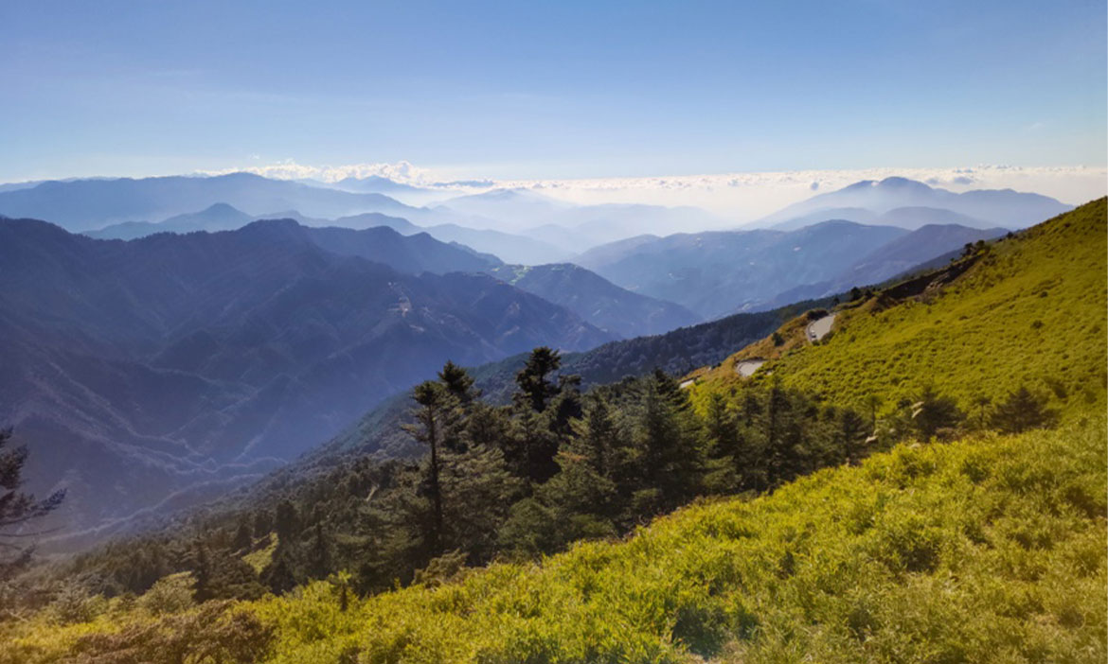

Notes:
stable diffusion：
masterpiece, best quality, 1boy, solo, next to the car, virtual youtuber, happy, hood, pants, shoes, jacket, white hoodie, white hair, gray eyes, hoodie, sneakers, hair between eyes, jewelry, grey pants, white footwear, bangs
我們家一直都很喜歡爬山，有一天決定要去合歡山上旅遊及看日出，戴上了裝備，全家便一起踏上了這段旅程。

Slide 5
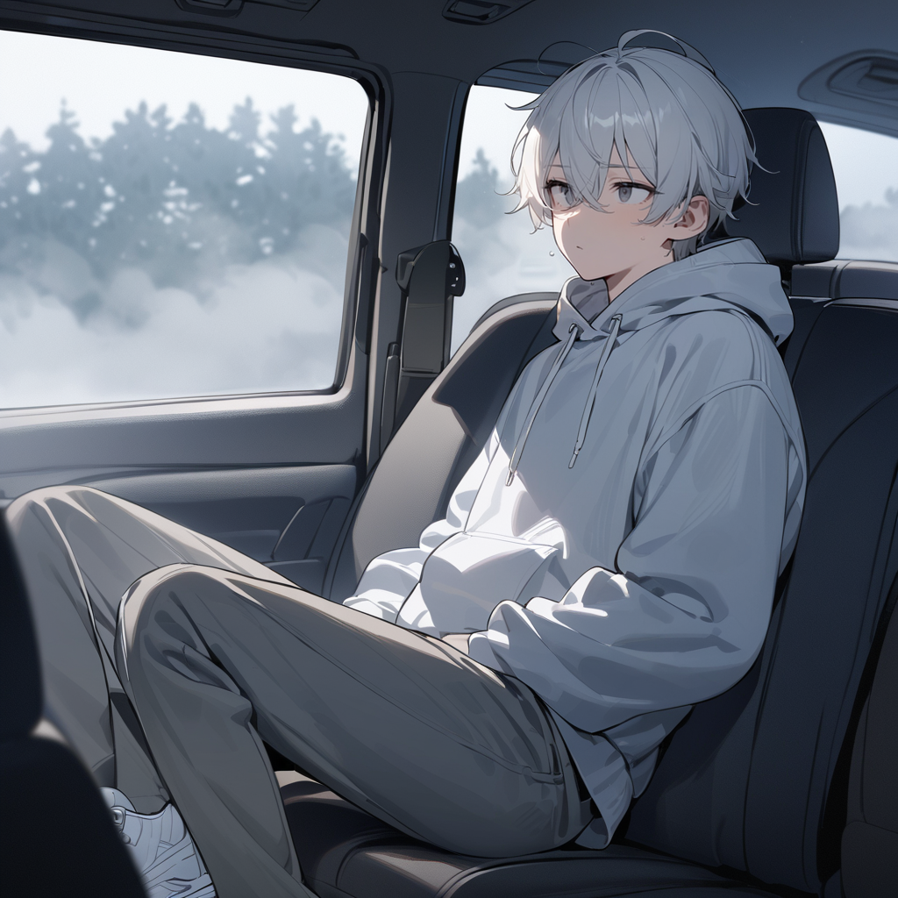
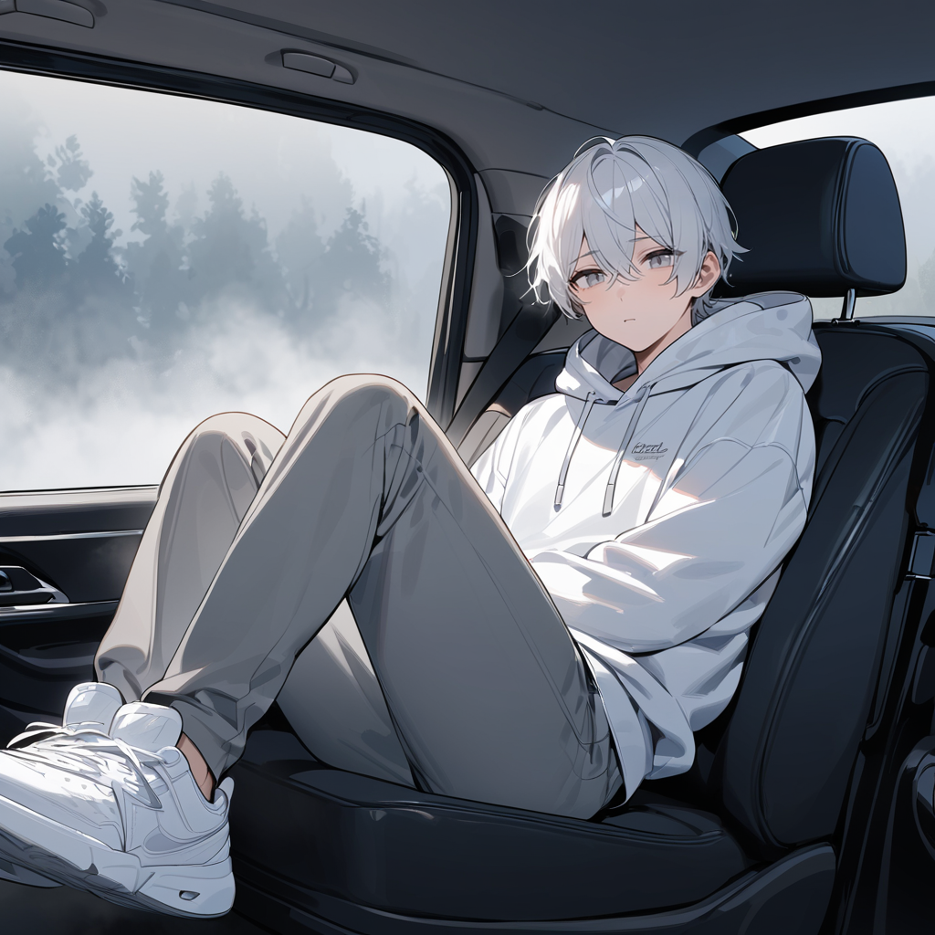
Notes:
stable diffusion：
masterpiece, best quality, 1boy, solo,in the car, the boy sitting in the back seat, thick fog, worry, hood, pants, shoes, jacket, white hoodie, white hair, gray eyes, hoodie, sneakers, hair between eyes, jewelry, grey pants, white footwear, bangs
我們首先要開車去松雪樓辦理住宿，但在開車到一半時，天氣忽然轉變，濃霧瞬間籠罩整座山，這對開車的父親而言是巨大的挑戰。

Slide 6

Notes:
stable diffusion：
masterpiece, best quality,1boy, solo,in the car, the boy sitting in the back seat, (Look out the car window:1.4), thick fog, worry, hood, pants, shoes, jacket, white hoodie, white hair, gray eyes, hoodie, sneakers, hair between eyes, jewelry, grey pants, white footwear, bangs
我們停止了在車上的喧鬧，不去打擾父親的專注，並幫忙仔細觀察周圍的路況，以便隨時通知，

Slide 7
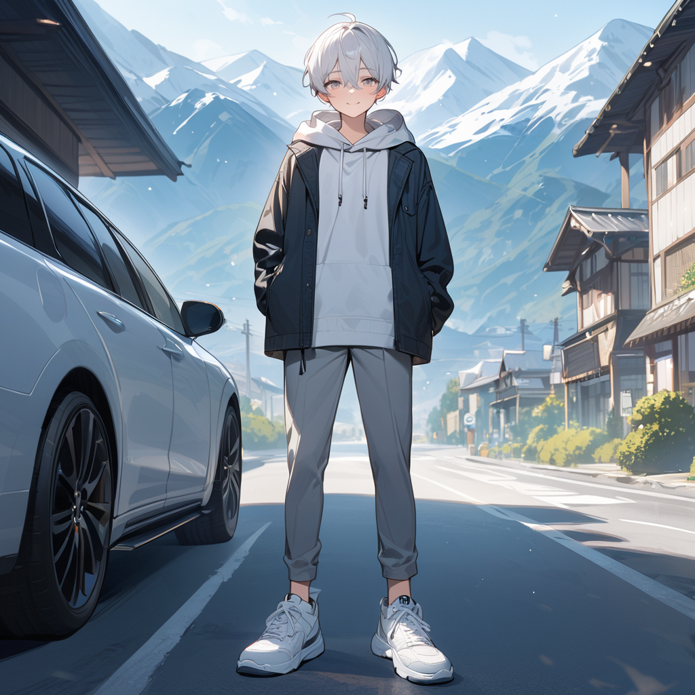
Notes:
stable diffusion：
masterpiece, best quality, 1boy, solo, mountain, outside the car, the boy Standing in front of the B&B, happy, hood, pants, shoes, jacket, white hoodie, white hair, gray eyes, hoodie, sneakers, hair between eyes, jewelry, grey pants, white footwear, bangs
在不久後濃霧散去，我們也順利抵達住宿的地方。

Slide 8
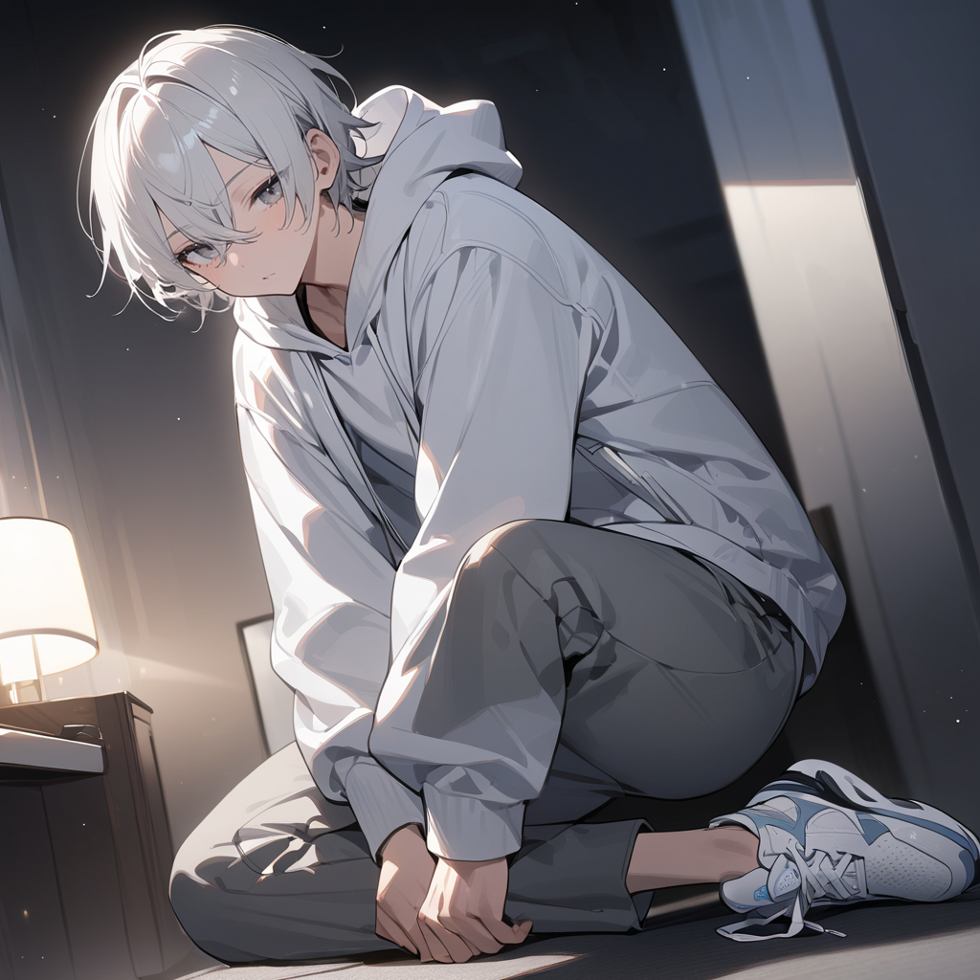
Notes:
stable diffusion：
masterpiece, best quality, 1boy, solo, Get up in the middle of the night, hood, pants, shoes, jacket, white hoodie, white hair, gray eyes, hoodie, sneakers, hair between eyes, jewelry, grey pants, white footwear, bangs
在吃飽喝足並休息一晚後，我們在約凌晨4點多時起床，準備去攀登附近的石門山

Slide 9

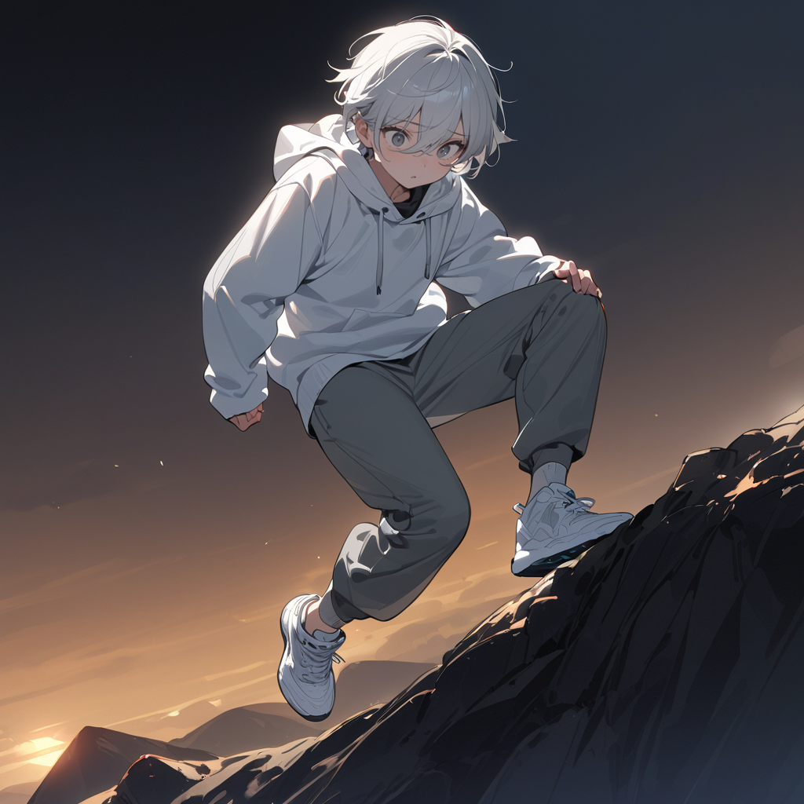
Notes:
stable diffusion：
masterpiece, best quality, 1boy, solo,dark night with little sunlight, starry sky, Climbing mountain, dangerous, frightened, hood, pants, shoes, jacket, white hoodie, white hair, gray eyes, hoodie, sneakers, hair between eyes, jewelry, grey pants, white footwear, bangs
但在此時意外發生了，俗話說天有不測風雲，凌晨的霧氣十分濃厚，且山風十分猛烈，爬向山頂的步道並沒有扶手，導致我被風吹的一個踉蹌，差點滾落山崖

Slide 10
Notes:
stable diffusion：
masterpiece, best quality, 1boy, solo,dark night with little sunlight, starry sky, Climbing mountain, dangerous, frightened, hood, pants, shoes, jacket, white hoodie, white hair, gray eyes, hoodie, sneakers, hair between eyes, jewelry, grey pants, white footwear, bangs
但在此時意外發生了，俗話說天有不測風雲，凌晨的霧氣十分濃厚，且山風十分猛烈，爬向山頂的步道並沒有扶手，導致我被風吹的一個踉蹌，差點滾落山崖

Slide 11
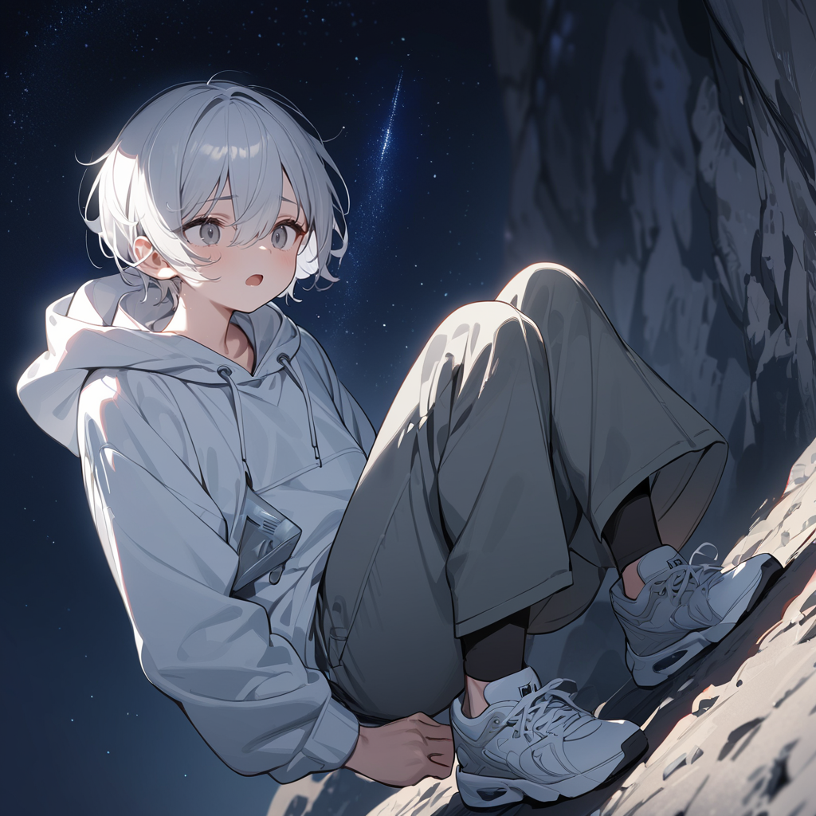
Notes:
stable diffusion：
masterpiece, best quality, 1boy, solo,dark night with little sunlight, starry sky, Climbing mountain, Take a deep breath, frightened, hood, pants, shoes, jacket, white hoodie, white hair, gray eyes, hoodie, sneakers, hair between eyes, jewelry, grey pants, white footwear, bangs
好在我成功穩住身形，深吸幾口氣平復情緒後，繼續向前邁進

Slide 12
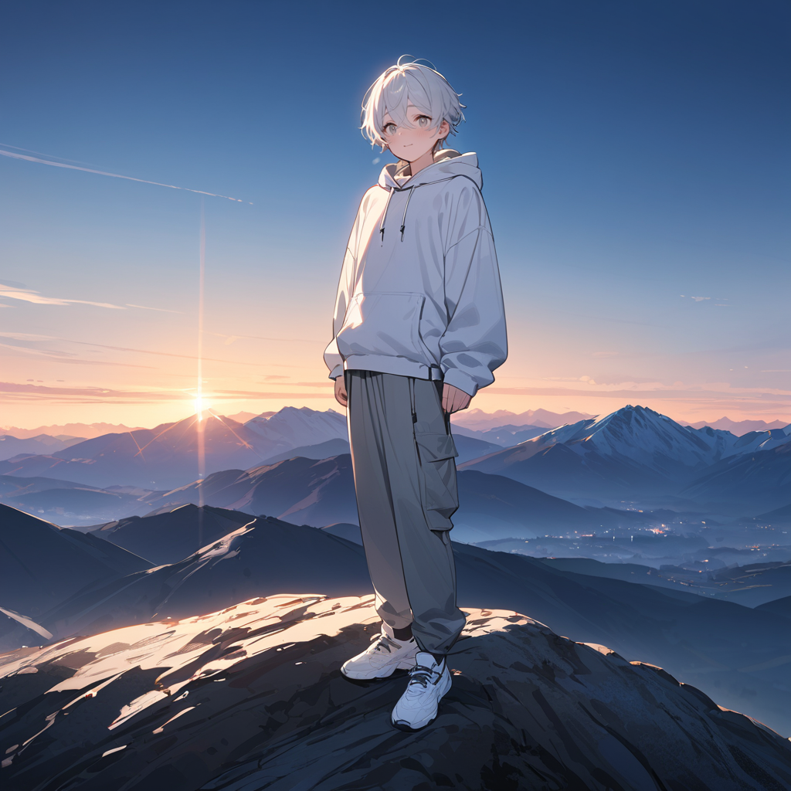

Notes:
stable diffusion：
masterpiece, best quality, 1boy, solo, top of mountain, watching sunrise, happy, frightened, hood, pants, shoes, jacket, white hoodie, white hair, gray eyes, hoodie, sneakers, hair between eyes, jewelry, grey pants, white footwear, bangs
最終，我們成功登上山頂，而周圍的雲霧也很識相的散開，看到了一片壯麗的景象。雖然日出已過，但餘暉灑在山脈上，景色同樣令人驚嘆。我站在山頂，感受著勝利的喜悅，明白了無論過程多麼艱辛，堅持與冷靜永遠是通往成功的關鍵。

